Slide 1
Network Security
Key Management and Authentication
Kamalika Bhattacharjee
Assistant Professor
Dept of CSE, NIT Trichy

Slide 2
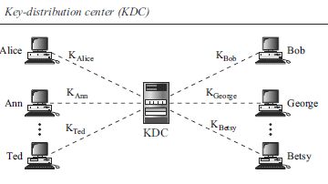
Symmetric-key Distribution
N people need to communicate with each other
N(N − 1) keys if use two keys for bidirectional communication;
N(N − 1)/2 keys if same keys for both directions
N^2 problem
Distribution of keys is even more challenging!
A practical solution is the use of a trusted third party: a key-distribution center (KDC).
To reduce the number of keys, each person establishes a shared secret key with the KDC

Slide 3
Symmetric-key Distribution
A secret key is established between the KDC and each member.
Alice has a secret key with the KDC, which we refer to as KAlice; Bob has a secret key with the KDC, which we refer to as KBob; and so on.
This secret key can be used only between the member and the KDC, not between two members.
Alice can send a confidential message to Bob as follows:
Alice sends a request to the KDC stating that she needs a session (temporary) secret key between herself and Bob.
The KDC informs Bob about Alice’s request.
If Bob agrees, a session key is created between the two.
Session Keys
A KDC can create a session key between Alice and Bob, using their keys with the center.
The keys of Alice and Bob are used to authenticate Alice and Bob to the center and to each other before the session key is established.
After communication is terminated, the session key is no longer useful.

Slide 4
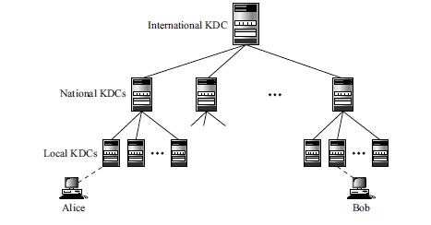
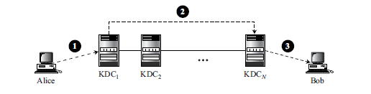
Types of KDCs
Flat multiple KDCs
Hierarchical multiple KDCs

Slide 5
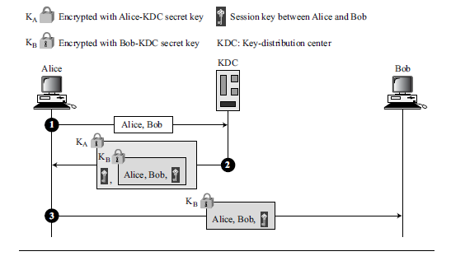
A Simple Protocol Using a KDC
Unfortunately, this simple protocol has a flaw.
Eve can use the replay attack. That is, she can save the message in step 3 and replay it later.

Slide 6
A Simple Protocol Using a KDC
Alice sends a plaintext message to the KDC to obtain a symmetric session key between Bob and herself. The message contains her registered identity (the word Alice in the figure) and the identity of Bob (the word Bob in the figure). This message is not encrypted, it is public. The KDC does not care.
The KDC receives the message and creates what is called a ticket. The ticket is encrypted using Bob’s key (KB). The ticket contains the identities of Alice and Bob and the session key (KAB). The ticket with a copy of the session key is sent to Alice. Alice receives the message, decrypts it, and extracts the session key. She cannot decrypt Bob’s ticket.
This message contains a double encryption; the ticket is encrypted, and the entire message is also encrypted.
Here, Alice is actually authenticated to the KDC, because only Alice can open the whole message using her secret key with KDC.
Alice sends the ticket to Bob. Bob opens the ticket and knows that Alice needs to send messages to him using KAB as the session key.
By this message, Bob is authenticated to the KDC because only Bob can open the ticket. Because Bob is authenticated to the KDC, he is also authenticated to Alice, who trusts the KDC. In the same way, Alice is also authenticated to Bob, because Bob trusts the KDC and the KDC has sent Bob the ticket that includes the identity of Alice.

Slide 7
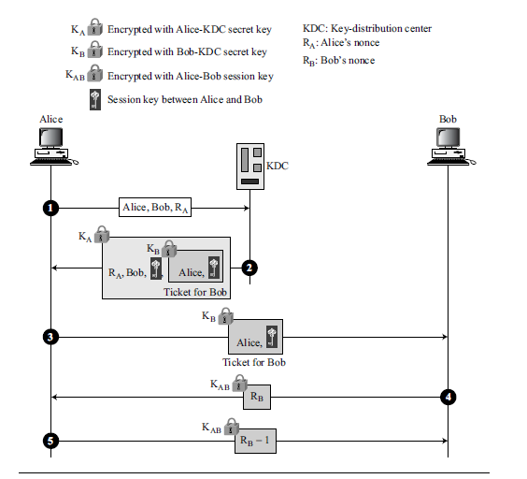
Needham-Schroeder Protocol
Uses multiple challenge-response interactions between parties to achieve a flawless protocol.
Two nonces: RA and RB

Slide 8
Needham-Schroeder Protocol
Alice sends a message to the KDC that includes her nonce, RA, her identity, and Bob’s identity.
The KDC sends an encrypted message to Alice that includes Alice’s nonce, Bob’s identity, the session key, and an encrypted ticket for Bob. The whole message is encrypted with Alice’s key.
Alice sends Bob’s ticket to him.
Bob sends his challenge to Alice (RB), encrypted with the session key.
Alice responds to Bob’s challenge. Note that the response carries RB − 1 instead of RB.

Slide 9
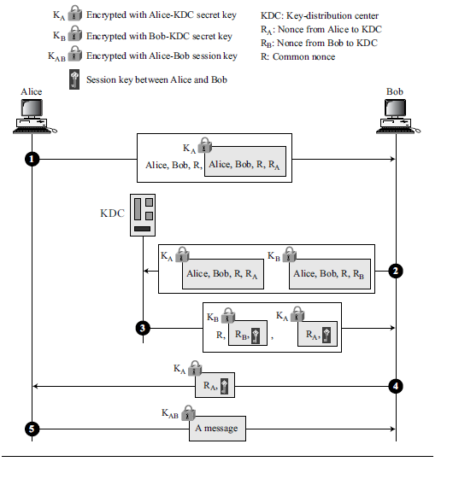
Otway-Rees Protocol
Alice sends a message to Bob that includes a common nonce, R, the identities of Alice and Bob, and a ticket for KDC that includes Alice’s nonce RA (a challenge for the KDC to use), a copy of the common nonce, R, and the identities of Alice and Bob.
Bob creates the same type of ticket, but with his own nonce RB. Both tickets are sent to the KDC.
The KDC creates a message that contains R, the common nonce, a ticket for Alice and a ticket for Bob; the message is sent to Bob. The tickets contain the corresponding nonce, RA or RB, and the session key, KAB.
Bob sends Alice her ticket.
Alice sends a short message encrypted with her session key KAB to show that she has the session key.

Slide 10

KERBEROS
An authentication protocol, and at the same time a KDC
Named after the three-headed dog in Greek mythology Cerberus that guards the gates of Hades
Designed at MIT (web.mit.edu/Kerberos)
Current verson: Kerberos 5 Release 1.20
We will discuss Kerberos 4
Three servers are involved in the Kerberos protocol:
An authentication server (AS),
A ticket-granting server (TGS),
A real (data) server that provides services to others.

Slide 11
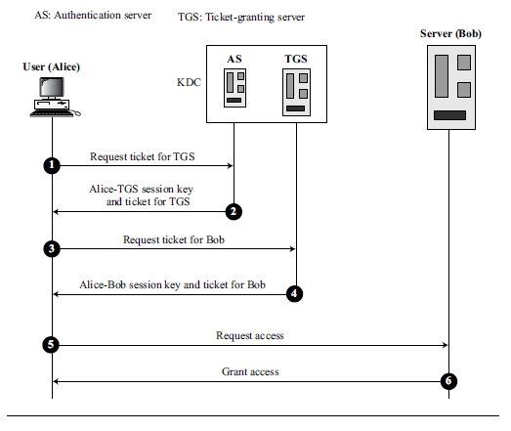
KERBEROS: Servers
Authentication Server (AS)
It is the KDC in the Kerberos protocol.
Each user registers with the AS and is granted a user identity and a password.
The AS has a database with these identities and the corresponding passwords.
The AS verifies the user, issues a session key to be used between Alice and the TGS, and sends a ticket for the TGS.

Slide 12
KERBEROS: Servers
Ticket-Granting Server (TGS)
It issues a ticket for the real server (Bob).
Also provides the session key (KAB) between Alice and Bob.
Kerberos has separated user verification from the issuing of tickets.
In this way, though Alice verifies her ID just once with the AS, she can contact the TGS multiple times to obtain tickets for different real servers.

Slide 13
KERBEROS: Servers
Real Server
The real server (Bob) provides services for the user (Alice).
Kerberos is designed for a client-server program, such as FTP, in which a user uses the client process to access the server process.
It is not used for person-to-person authentication.

Slide 14
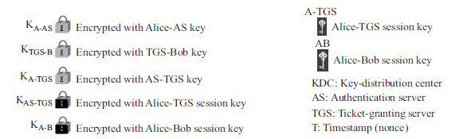
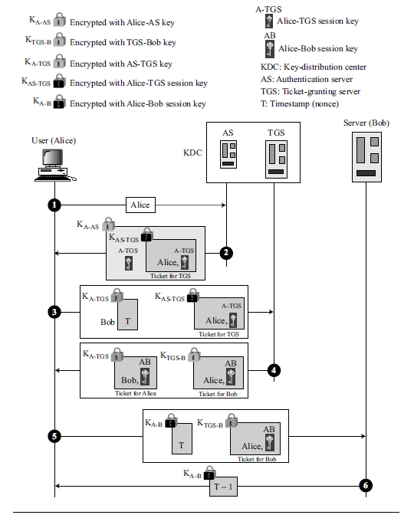
KERBEROS: Servers
if Alice needs to receive services from different servers, she need repeat only the last four steps.
The first two steps have verified Alice’s identity and need not be repeated.
Alice can ask TGS to issue tickets for multiple servers by repeating steps 3 to 6.

Slide 15
KERBEROS: Operation
Alice sends her request to the AS in plain text using her registered identity.
The AS sends a message encrypted with Alice’s permanent symmetric key, KA-AS.
The message contains two items: a session key, KA-TGS, that is used by Alice to contact the TGS, and a ticket for the TGS that is encrypted with the TGS symmetric key, KAS-TGS.
Alice does not know KA-AS, but when the message arrives, she types her symmetric password. The password and the appropriate algorithm together create KA-AS if the password is correct.
The password is then immediately destroyed; it is not sent to the network and it does not stay in the terminal. It is used only for a moment to create KA-AS.
The process now uses KA-AS to decrypt the message sent. KA-TGS and the ticket are extracted.
Alice now sends three items to the TGS. The first is the ticket received from the AS. The second is the name of the real server (Bob), the third is a timestamp that is encrypted by KA-TGS. The timestamp prevents a replay by Eve.

Slide 16
KERBEROS: Operation
Now, the TGS sends two tickets, each containing the session key between Alice and Bob, KA-B.
The ticket for Alice is encrypted with KA-TGS; the ticket for Bob is encrypted with Bob’s key, KTGS-B.
Eve cannot extract KAB because Eve does not know KA-TGS or KTGS-B. She cannot replay step 3 because she cannot replace the timestamp with a new one (she does not know KA-TGS). Even if she is very quick and sends the step 3 message before the timestamp has expired, she still receives the same two tickets that she cannot decipher.
Alice sends Bob’s ticket with the timestamp encrypted by KA-B.
Bob confirms the receipt by adding 1 to the timestamp. The message is encrypted with KA-B and sent to Alice.

Slide 17
KERBEROS: Realm
Kerberos allows the global distribution of ASs and TGSs, with each system called a realm.
A user may get a ticket for a local server or a remote server.
In the second case, for example, Alice may ask her local TGS to issue a ticket that is accepted by a remote TGS.
The local TGS can issue this ticket if the remote TGS is registered with the local one.
Then Alice can use the remote TGS to access the remote real server.

Slide 18
Symmetric-key Agreement
Can create a session key between themselves without using a KDC
This method of session-key creation is referred to as the symmetric-key agreement.
Two common methods:
Diffie-Hellman
Station-to-station

Slide 19
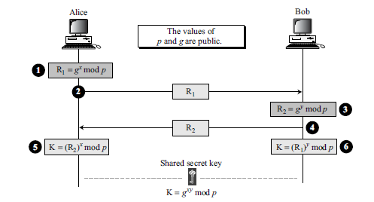
Diffie-Hellman method
Before establishing a symmetric key, the two parties need to choose two numbers p and g.
The first number, p, is a large prime number on the order of 300 decimal digits (1024 bits).
The second number, g, is a generator of order p − 1 in the group <Zp*, ×>
K is the symmetric key for the session.

Slide 20
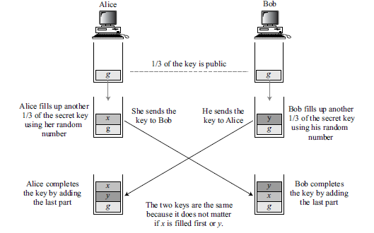
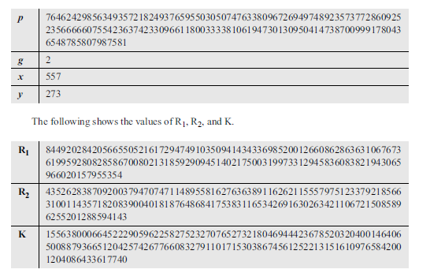
Diffie-Hellman Idea
Example:
Choose an integer p which is a 159-digit number. We also choose g, x, and y as shown below:

Slide 21
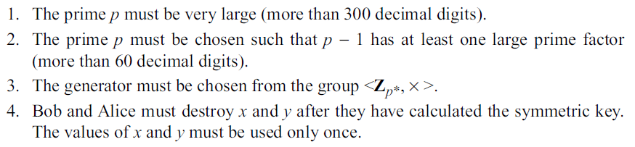

Diffie-Hellman: Security Attacks
Discrete Logarithm Attack
The security of the key exchange is based on the difficulty of the discrete logarithm problem
Eve can intercept R1 and R2. If she can find x from R1 and y from R2, then she can calculate the symmetric key K = $g^{κy}$ mod p.
To prevent:

Slide 22
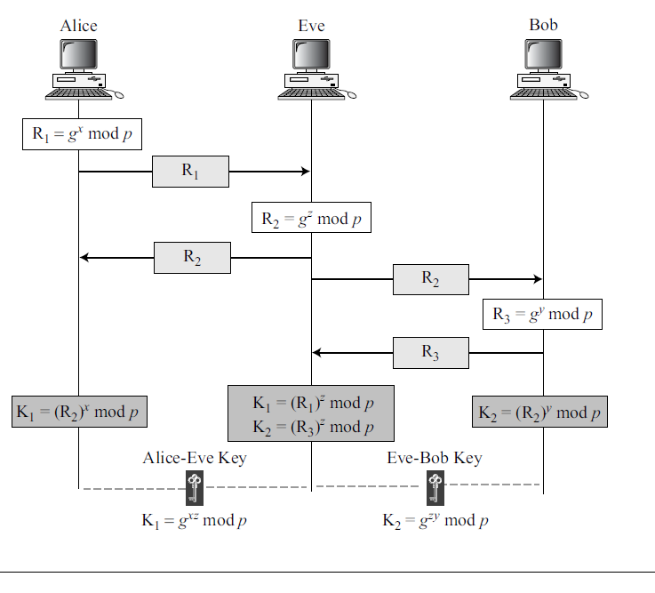
Diffie-Hellman: Security Attacks
Man-in-the-Middle Attack
No need have to find the value of x and y to attack the protocol.
One can fool Alice and Bob by creating two keys: one between herself and Alice, and another between herself and Bob
Also called Bucket Brigade Attack
To prevent, next method based on the Diffie-Hellman uses authentication.

Slide 23
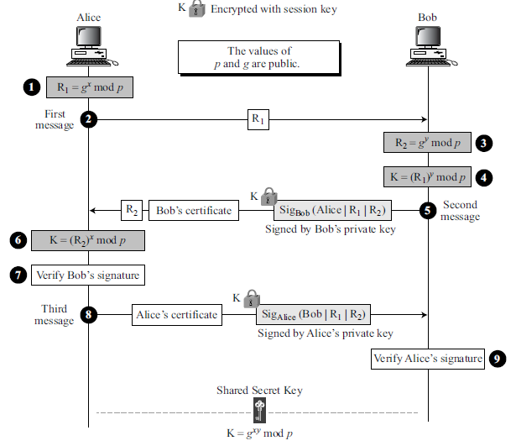
Station-to-Station Key Agreement
Based on Diffie-Hellman
Uses digital signatures with public-key certificates to establish a session key
Prevents man-in-the-middle attacks
After intercepting R1, Eve cannot send her own R2 to Alice and pretend it is coming from Bob because Eve cannot forge the private key of Bob to create the signature - the signature cannot be verified with Bob’s public key defined in the certificate.
In the same way, Eve cannot forge Alice’s private key to sign the third message sent by Alice.
The certificates are trusted because they are issued by trusted authorities.

Slide 24
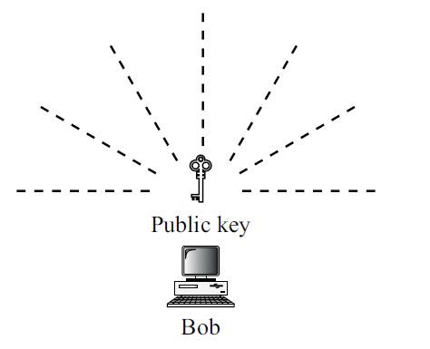
Public-key Distribution
Everyone has access to everyone’s public key; public keys are available to the public. Public keys also need to be distributed to be useful.
Naive approach: Public Announcement
Not secure; it is subject to forgery
Eve could make such a public announcement and can fool Alice into sending her a message that is intended for Bob. Eve could also sign a document with a corresponding forged private key and make everyone believe it was signed by Bob.
Also vulnerable if Alice directly requests Bob’s public key. Eve can intercept Bob’s response and substitute her own forged public key for Bob’s public key.

Slide 25
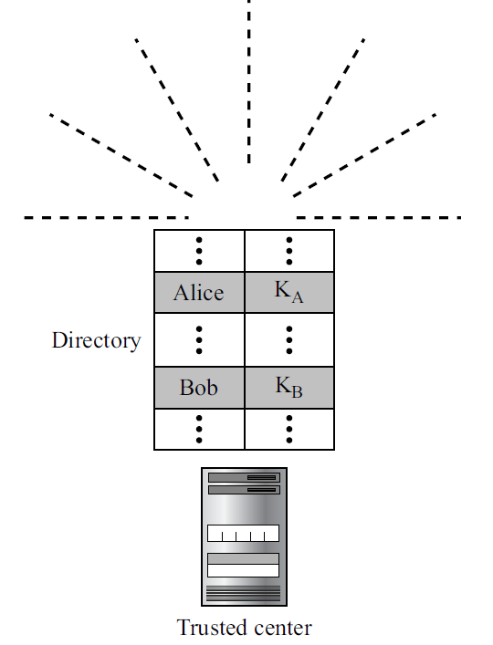
Trusted Center
A more secure approach is to have a trusted center retain a directory of public keys.
The directory is dynamically updated.
Each user can select a private and public key, keep the private key, and deliver the public key for insertion into the directory.
The center requires that each user register in the center and prove his or her identity.
The directory can be publicly advertised by the trusted center.
The center can also respond to any inquiry about a public key

Slide 26
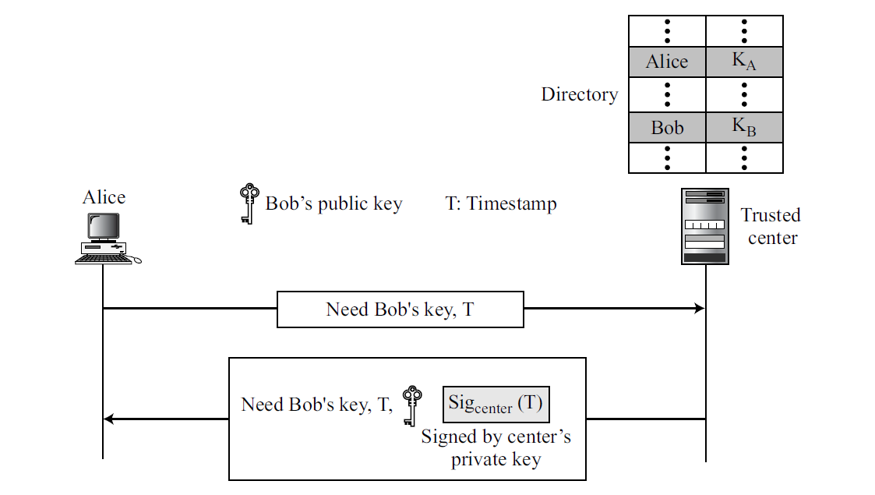
Controlled Trusted Center
Added controls on the distribution of the public key.
The public-key announcements can include a timestamp and be signed by an authority to prevent interception and modification of the response.

Slide 27
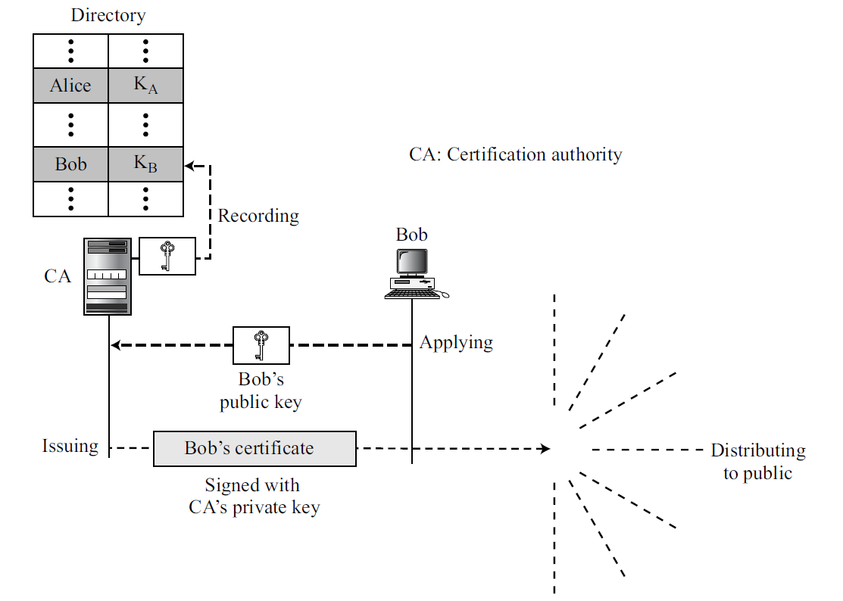
Certification Authority
The previous approach can create a heavy load on the center if the number of requests is large.
Alternative is to create public-key certificates.
Requirement:
Let people know your public key, and let no one to accept a forged public key as yours.
Certification authority (CA):
A federal or state organization that binds a public key to an entity and issues a certificate.
CA has a well-known public key itself that cannot be forged.

Slide 28
Certification Authority
It checks your identification (using a picture ID along with other proof).
It then asks for your public key and writes it on the certificate.
To prevent the certificate itself from being forged, the CA signs the certificate with its private key.
Now you can upload the signed certificate.
Anyone who wants your public key downloads the signed certificate and uses the center’s public key to extract your public key

Slide 29
X.509
Each certificate may have a different format
Anything that needs to be used universally must have a universal format.
To remove this side effect, the ITU has designed X.509, a recommendation that has been accepted by the Internet with some changes.
X.509 is a way to describe the certificate in a structured way.
Uses a well-known protocol called ASN.1 (Abstract Syntax Notation 1)

Slide 30
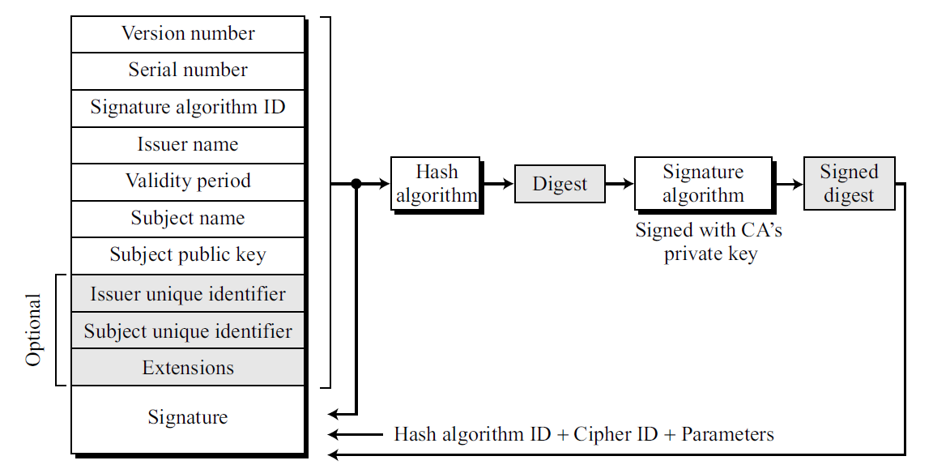
X.509: Certificate Format

Slide 31
X.509: Certificate
Version number: defines the version of X.509 of the certificate. The version number started at 0; the current version (third version) is 2.
Serial number: defines a number assigned to each certificate. The value is unique for each certificate issuer.
Signature algorithm ID: identifies the algorithm used to sign the certificate. Any parameter that is needed for the signature is also defined in this field.
Issuer name: identifies the certification authority that issued the certificate. The name is normally a hierarchy of strings that defines a country, a state, organization, department, and so on.
Validity Period: defines the earliest time (not before) and the latest time (not after) the certificate is valid.

Slide 32
X.509: Certificate
Subject name: defines the entity to which the public key belongs. It is also a hierarchy of strings. Part of the field defines common name, which is the actual name of the beholder of the key.
Subject public key: defines the owner’s public key, the heart of the certificate. Also defines the corresponding public-key algorithm and its parameters.
Issuer unique identifier: This optional field allows two issuers to have the same issuer field value, if the issuer unique identifiers are different.
Subject unique identifier. This optional field allows two different subjects to have the same subject field value, if the subject unique identifiers are different.
Extensions: This optional field allows issuers to add more private information to the certificate.

Slide 33
X.509: Certificate
Signature: made of three sections
First section contains all other fields in the certificate
Second section contains digest of the first section encrypted with the CA’s public key.
Third section contains the algorithm identifier used to create the second section.
Certificate Renewal:
Each certificate has a period of validity.
If there is no problem with the certificate, the CA issues a new certificate before the old one expires.
The process is like the renewal of credit cards

Slide 34
X.509: Certificate Revocation
In some cases a certificate must be revoked before its expiration:
The user’s (subject’s) private key (corresponding to the public key listed in the certificate) might have been comprised.
The CA is no longer willing to certify the user. For example, the user’s certificate relates to an organization that she no longer works for.
The CA’s private key, which can verify certificates, may have been compromised. In this case, the CA needs to revoke all unexpired certificates.
The revocation is done by periodically issuing a certificate revocation list (CRL). The list contains all revoked certificates that are not expired on the date the CRL is issued.
When a user wants to use a certificate, she first needs to check the directory of the corresponding CA for the last certificate revocation list.

Slide 35
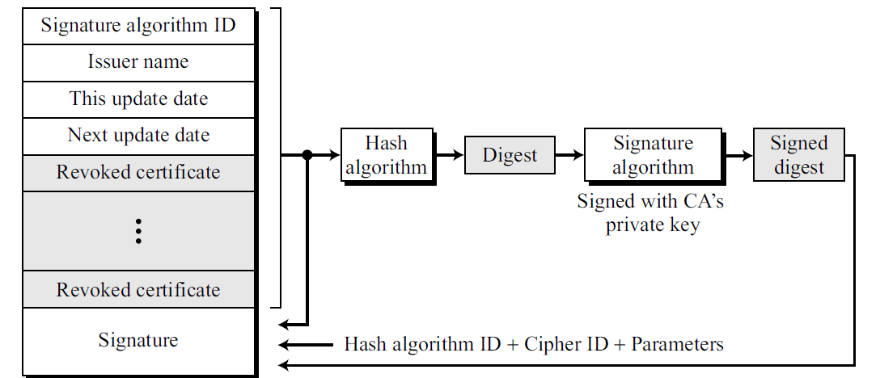
X.509: Certificate Revocation
Signature algorithm ID, Issuer name, Signature: same as the one in the certificate.
This update date: defines when the list is released.
Next update date: defines the next date when the new list will be released.
Revoked certificate: This is a repeated list of all unexpired certificates that have been revoked.
Each list contains two sections: user certificate serial number and revocation date.

Slide 36
X.509: Certificate Revocation
Delta Revocation
To make revocation more efficient, the delta certificate revocation list (delta CRL) has been introduced.
A delta CRL is created and posted on the directory if there are changes after this update date and next update date.
For example, if CRLs are issued every month, but there are revocations in between, the CA can create a delta CRL when there is a change during the month.
A delta CRL contains only the changes made after the last CRL.

Slide 37
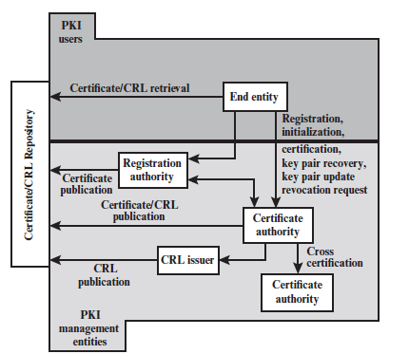
Public-Key Infrastructures (PKI)
Model for creating, distributing, and revoking certificates based on X.509.
Internet Engineering Task Force has created Public-Key Infrastructure X.509 (PKIX).
End entity: A generic term used to denote end users, devices (e.g., servers, routers), or any other entity that can be identified in the subject field of a public-key certificate.
Registration authority (RA): An optional component that assumes a number of administrative functions from the CA. Often associated with end entity registration
CRL issuer: An optional component that a CA can delegate to publish CRLs.
Repository: A generic term used to denote any method for storing certificates and CRLs so that they can be retrieved by end entities.
PKIX Architectural Model

Slide 38
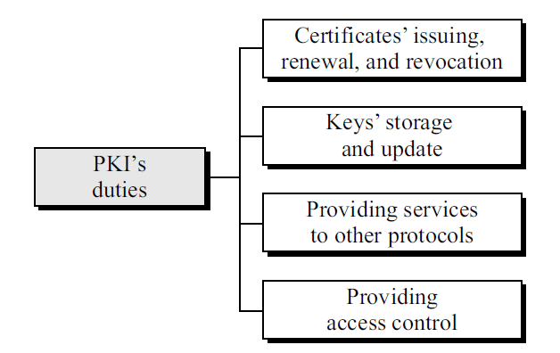
Public-Key Infrastructures (PKI)
Some important Duties:
Certificates’ issuing, renewal, and revocation: duties defined in X.509.
Keys’ storage and update: A PKI should be a storage place for private keys of those members that need to hold their private keys somewhere safe. In addition, a PKI is responsible for updating these keys on members’ demands.

Slide 39
Public-Key Infrastructures (PKI)
Some important Duties:
Providing services to other protocols: Like IPSec and TLS relying on services by a PKI.
Providing access control. A PKI can provide different levels of access to the information stored in its database. For example, an organization PKI may provide access to the whole database for the top management, but limited access for employees.

Slide 40
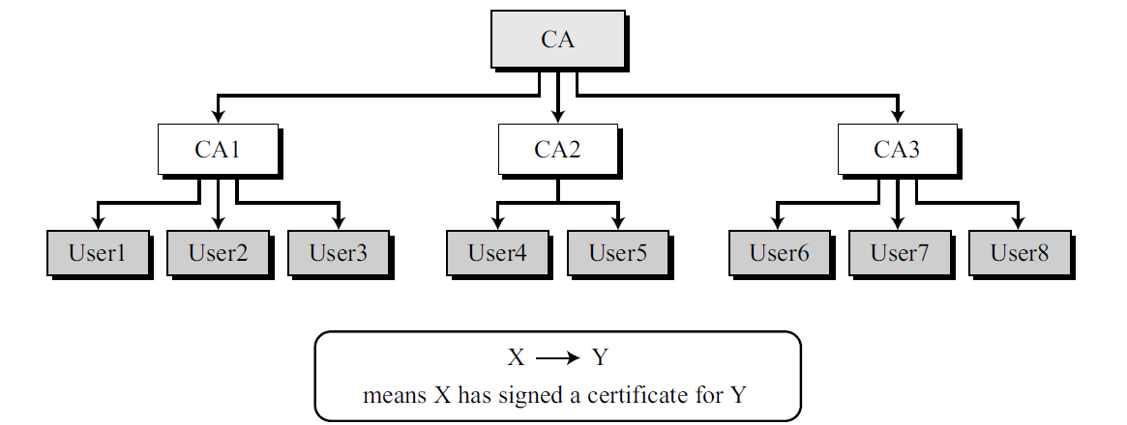
PKI Hierarchical Model
Trust model defines rules that specify how a user can verify a certificate received from a CA
Hierarchical Model is a tree-type structure with a root CA. The root CA has a self-signed, self-issued certificate; it needs to be trusted by other CAs and users for the system to work
Example: How User1, knowing only the public key of the CA (the root), can obtain a verified copy of
User3’s public key?
User3 sends a chain of certificates, CA<<CA1>> and CA1<<User3>>, to User1
Certificate issued by authority X for entity Y: X<<Y>>

Slide 41
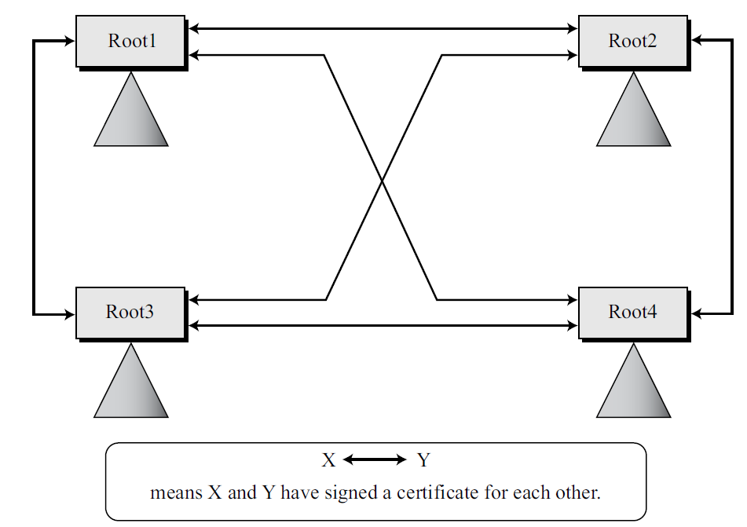
PKI Mesh Model
A larger community may need several hierarchical structures connected together.
One method is to use a mesh model to connect the roots together. In this model, each root is connected to every other root,
The certifications between the roots are cross-certificates
Each root certifies all other roots, which means there are N(N − 1) certificates
Web of Trust: This model is used in Pretty Good Privacy

Slide 42
Entity Authentication
Technique designed to let one party prove the identity of another party.
An entity can be a person, a process, a client, or a server.
The entity whose identity needs to be proved is called the claimant; the party that tries to prove the identity of the claimant is called the verifier.
Data-Origin Versus Entity Authentication
Message authentication (or data-origin authentication) might not happen in real time; entity authentication does
Data-origin authentication example: Email; Entity authentication example: ATM transaction
Message authentication simply authenticates one message; the process needs to be repeated for each new message.
Entity authentication authenticates the claimant for the entire duration of a session

Slide 43
Verification Categories
In entity authentication, the claimant must identify herself to the verifier
Something known: This is a secret known only by the claimant that can be checked by the verifier. Examples: password, PIN, secret key, private key.
Something possessed: This is something that can prove the claimant’s identity. Examples: passport, driver’s license, identification card etc.
Something inherent: This is an inherent characteristic of the claimant. Examples: conventional signatures, fingerprints, voice, facial characteristics, retinal pattern, and handwriting.

Slide 44
Verification Categories
In entity authentication, the claimant must identify herself to the verifier
Something known: This is a secret known only by the claimant that can be checked by the verifier. Examples: password, PIN, secret key, private key.
Something possessed: This is something that can prove the claimant’s identity. Examples: passport, driver’s license, identification card etc.
Something inherent: This is an inherent characteristic of the claimant. Examples: conventional signatures, fingerprints, voice, facial characteristics, retinal pattern, and handwriting.

Slide 45
Zero-Knowledge
In zero-knowledge authentication, the claimant proves that she knows a secret without revealing it.

